Slide 1








Autonomous RC Car

Slide 2

Group ID:
. 0112072420
TEAMWORK:
Omar Mohamed Hamdy
Omar Khaled Sief El-Nasr

Slide 3

CONTENTS:
1
Introduction
2
Components & Circuit design
3
Atmega32 code for Autonomous RC Car
4
Advantages of Our Autonomous RC Car Project

Slide 4
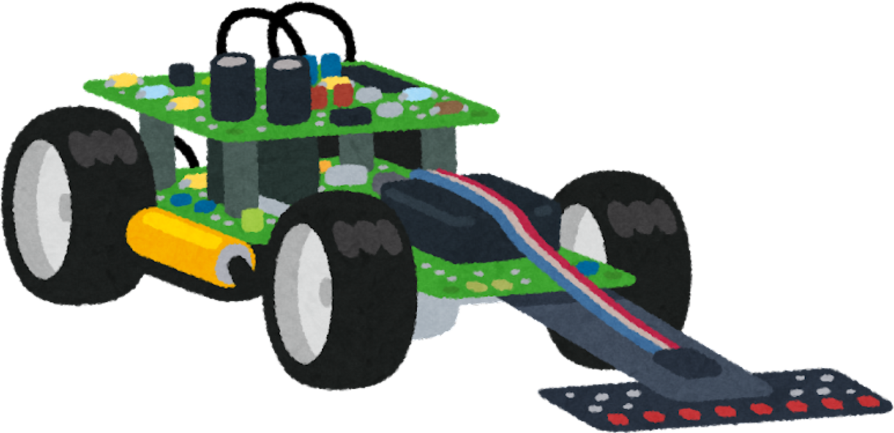

Introduction
This project presents the design and development of a smart RC car that integrates autonomous navigation with manual control via Bluetooth. The system is powered by an ATmega32 microcontroller, programmed in C, and features an intelligent path-following algorithm combined with real-time obstacle avoidance. The vehicle is designed for applications in autonomous robotics, embedded systems research, and educational purposes.
Objectives
1-DESIGN
2-DEVELOP
3-OPTIMIZE
4-INTEGRATE

Slide 5
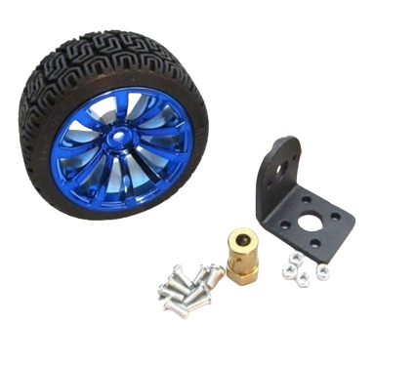

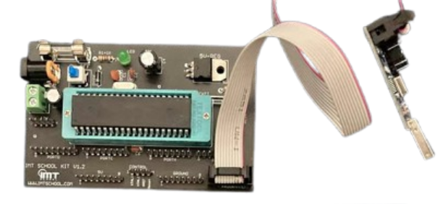
Components
Wheels
to provide the necessary force for pushing the opponent (65mm wheels)
Microcontroller
The brain of the robot, for autonomous decision-making. (Atmega32)

Slide 6
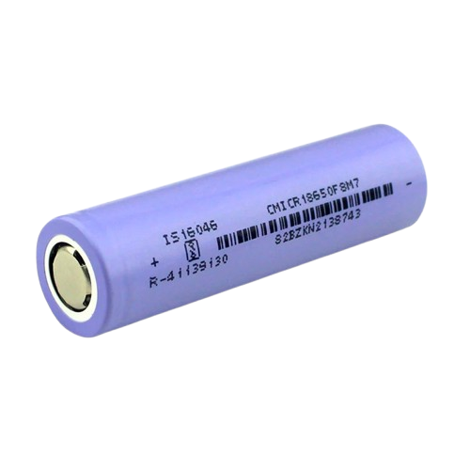
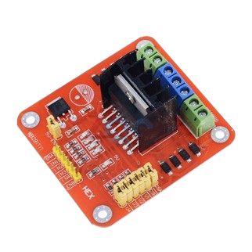
Components
Power Supply
Power Supply 3.7V Lithium-Ion Rechargeable (4) Rechargeable batteries or other efficient power sources to ensure sustained performance during competitions.
L298N Motor drive
system that includes a motor that has multiple operating speeds (H Bridge)

Slide 7
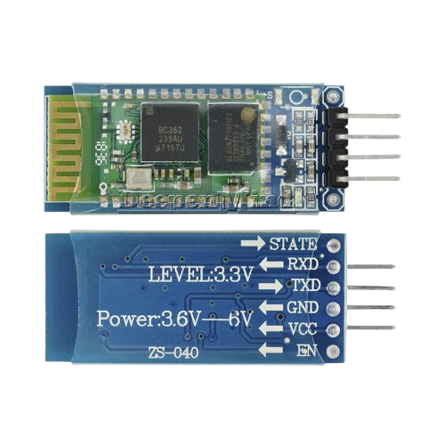
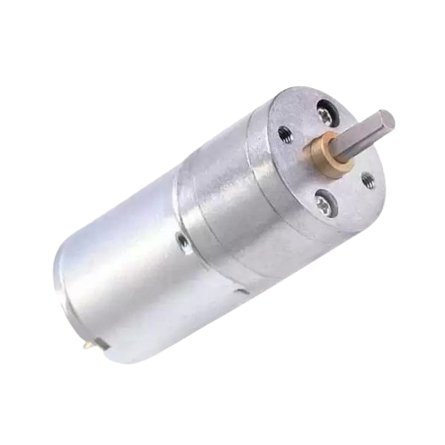
Components
Bluetooth Module
a basic circuit set of chip which integrated Bluetooth functions and which can be used in wireless network transmission to control the project (HC-06)
Motor
motors to provide the necessary force for move the car

Slide 8
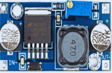
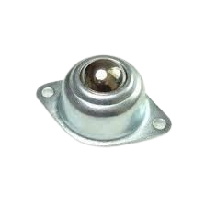
Components
LM2596
series of regulators are monolithic integrated circuits that provide all the active functions for a step-down (buck) switching regulator used for step down the voltage from 15v to 12v
Caster wheel 20mm
durable and reliable wheel that is ideal for use in The project

Slide 9
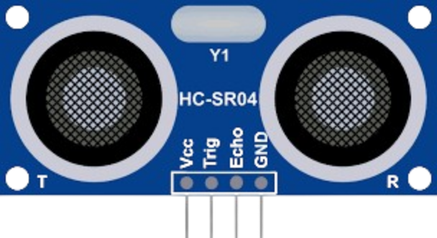
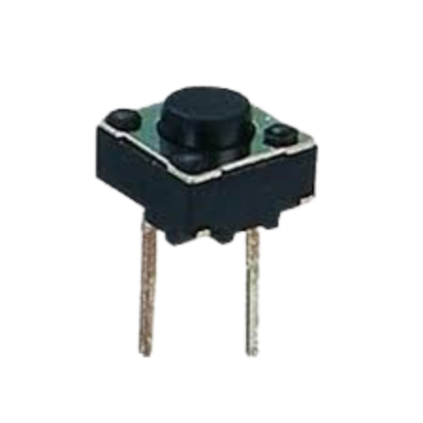
Components
Ultrasonic Sensor Module
An ultrasonic sensor measures distance using high-frequency sound waves. The transmitter emits pulses, and the receiver detects the reflected waves. Distance is calculated based on the time taken for the waves to return.
switch
To switch between 2 mode RC & obstacle avoidance mode

Slide 10
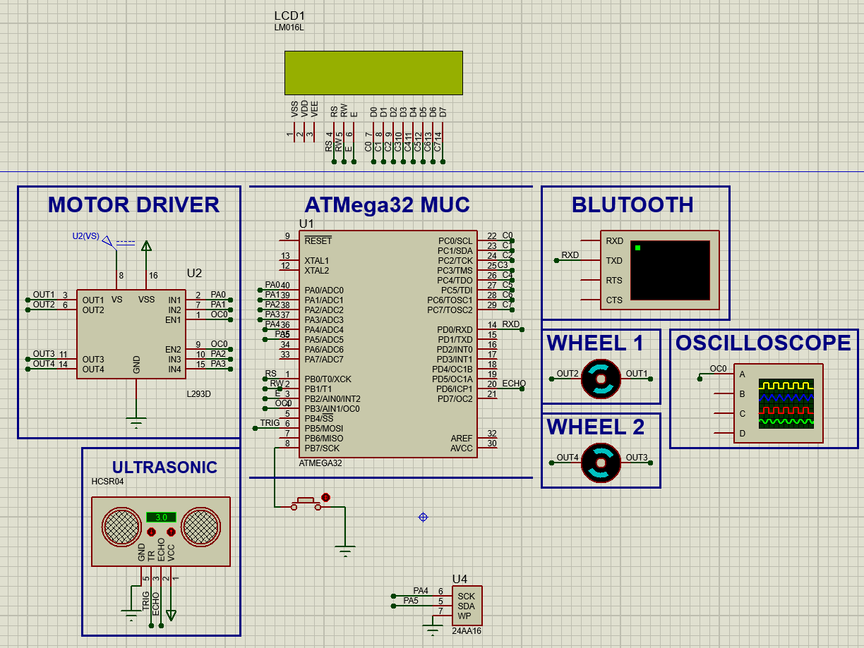
Circuit design

Slide 11

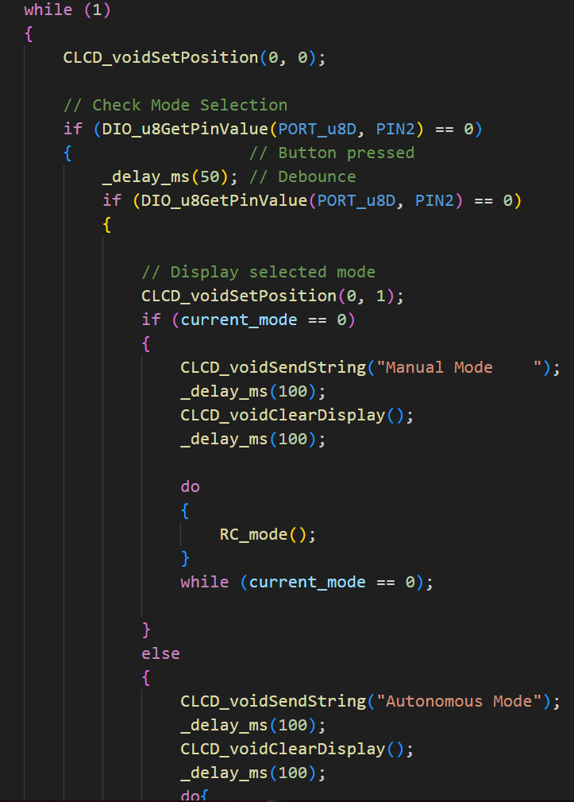
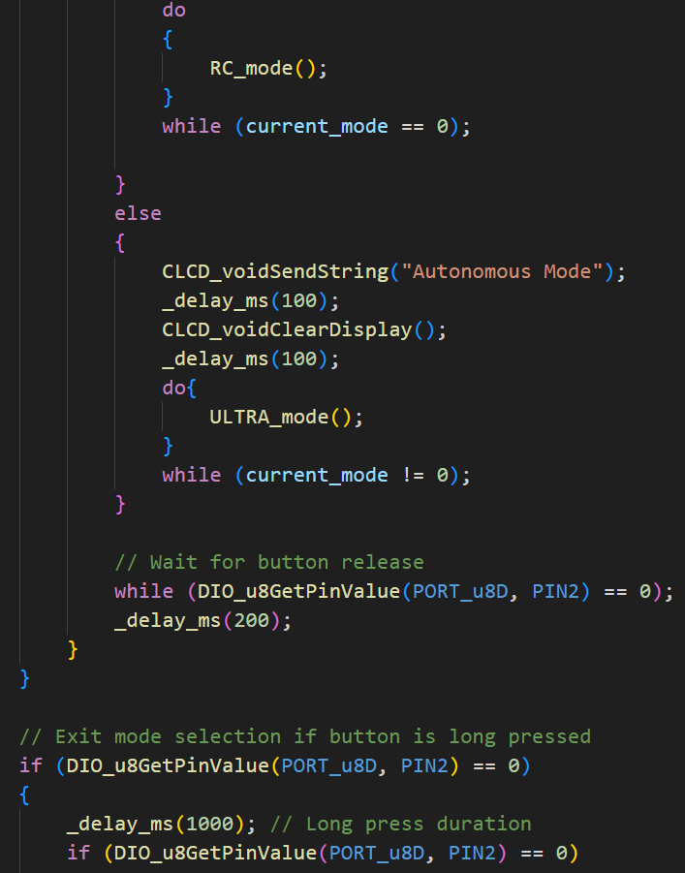
Atmega32 code for Autonomous RC Car

Slide 12
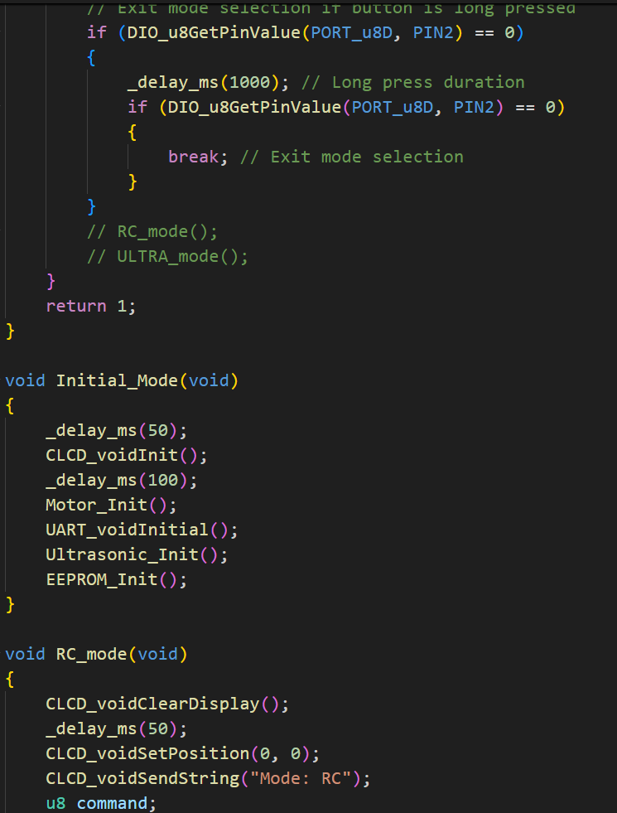
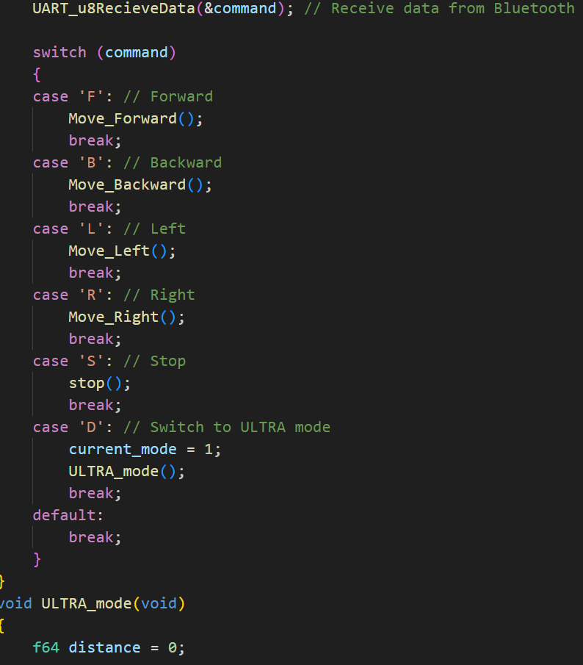
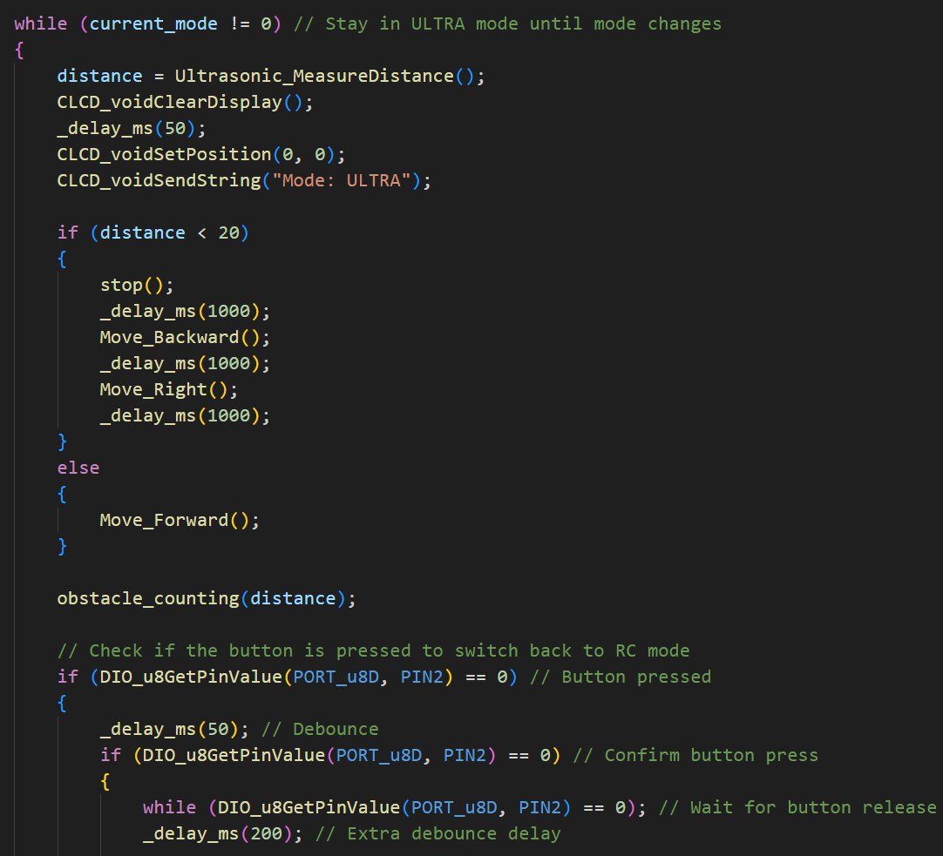
Atmega32 code for Autonomous RC Car

Slide 13

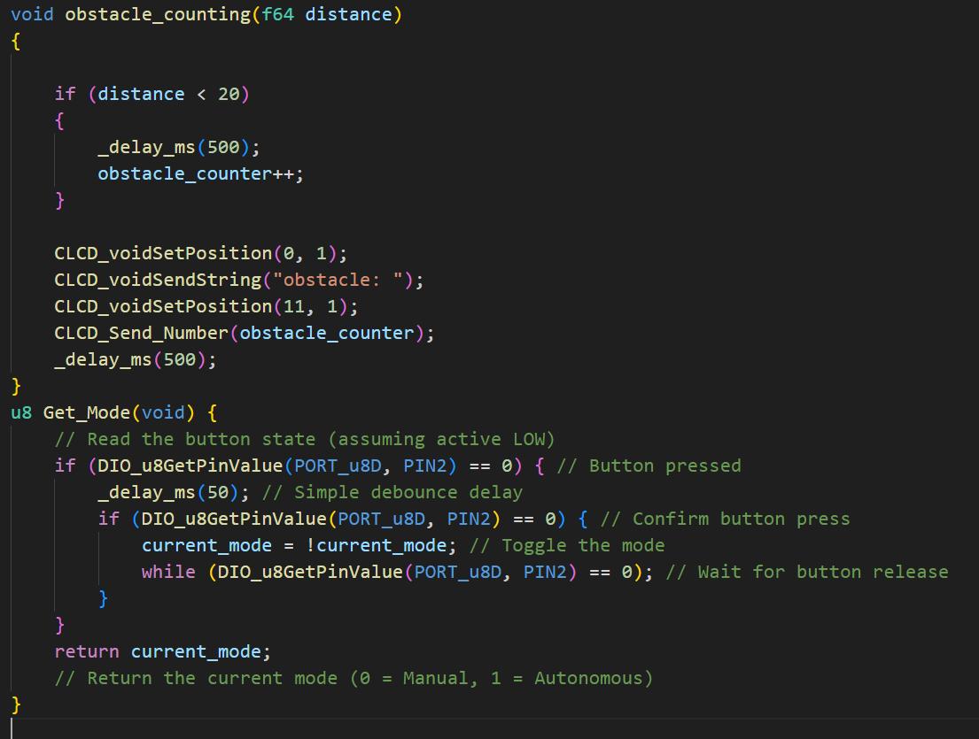
Atmega32 code for Autonomous RC Car

Slide 14
Advantages of Our Atmega32 Autonomous RC Car
Intelligent Control System
Optimized Physical Structure
Educational and Developmental Value
Use of Advanced Components
Practical Applications and Testing

Slide 15




Thank you all

